Slide 1
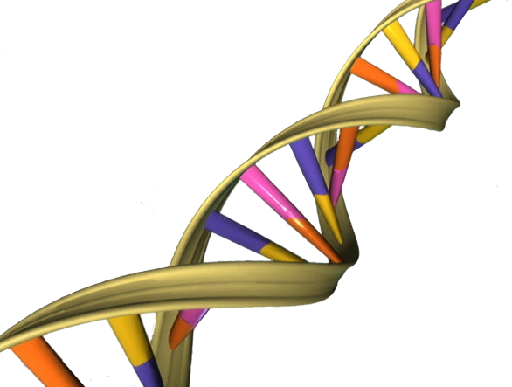
ACGCACTTCAGAACGCGTACTGACTGAA
TGCGTGAAGTCTTGCGCATGACTGACTT
2
3
4

Slide 2
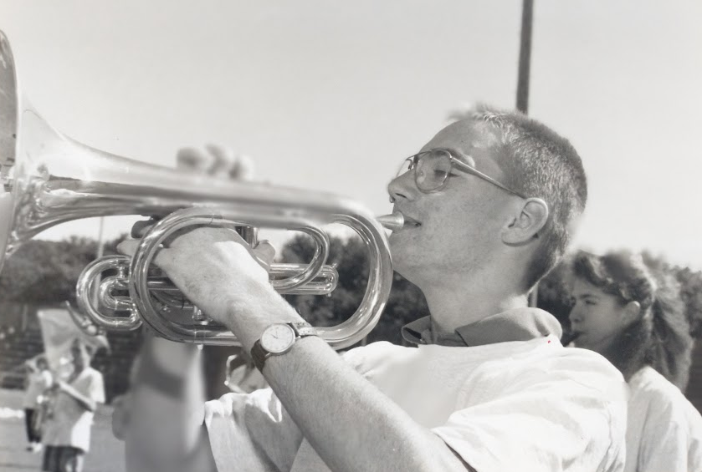
Why am I here?
Placeholder for DNA Day ambassador picture from high school years (candid, extracurricular, senior picture, etc).
Notes:
Why do I love science?
What was important to me back in high school?
What do I study?

Slide 3
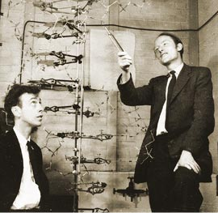
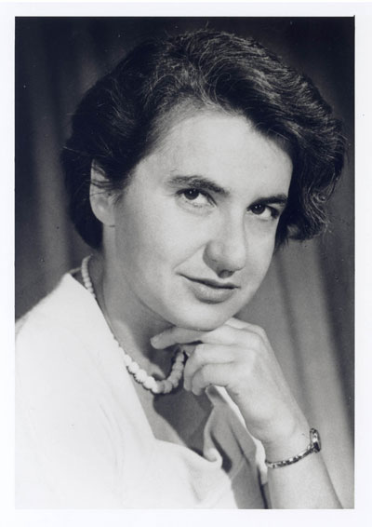
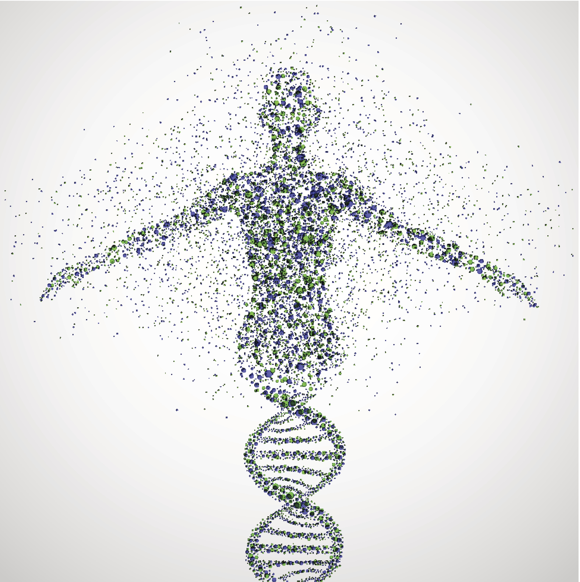
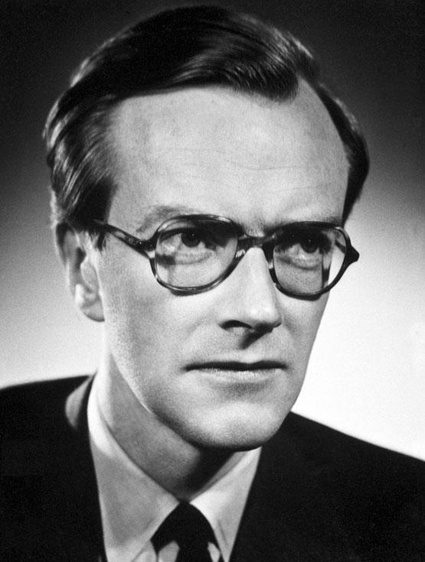
What is DNA Day?
April 1953
Drs. James Watson and Francis Crick determined the structure of DNA (double helix) with contributions by Drs. Rosalind Franklin and Maurice Wilkins
April 2003
Human Genome Project determined the entire DNA sequence of a human (3 billion letters)
Image credit: canerquest.org
Notes:
What is DNA Day?
The story of DNA began on April 25, 1953, when doctors James Watson and Francis Crick determined the structure of DNA. They built upon (or some might say, they stole) work of Drs. Rosalind Franklin and Maurice Wilkins. 50 years later, in April 2003, the Human Genome Project determined the entire sequence of human DNA. Research scientists are using the knowledge and technology generated by this project to further understand how your DNA is causing or contributing to disease.

Slide 4
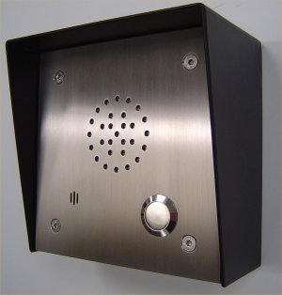
Urgent Announcement from the Principal!
Read “Missing Mascot” Skit
Notes:
Select 4 student volunteers to perform skit. Role of the principal may be played by the ambassador or a student. Hint: Get information on Principals name and school mascot before hand.

Slide 5
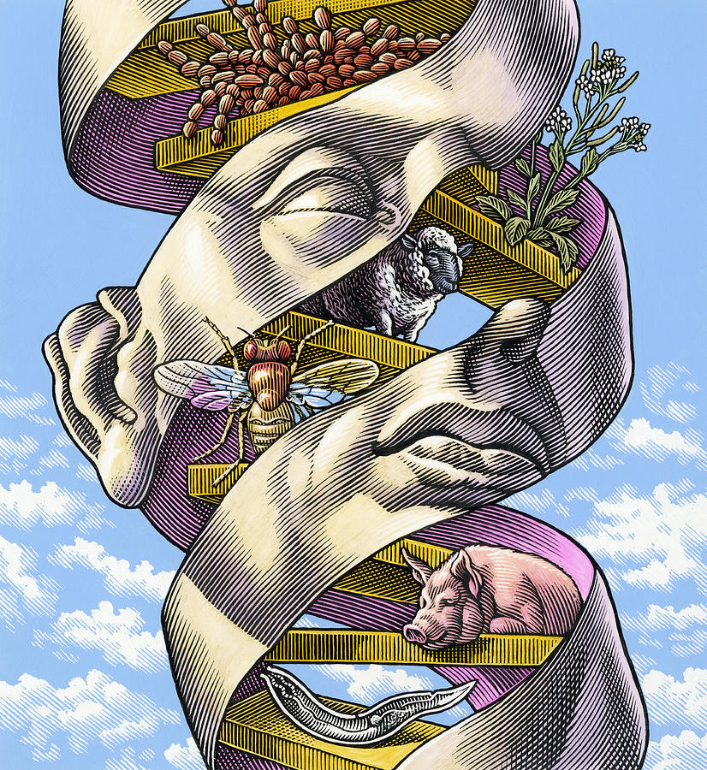
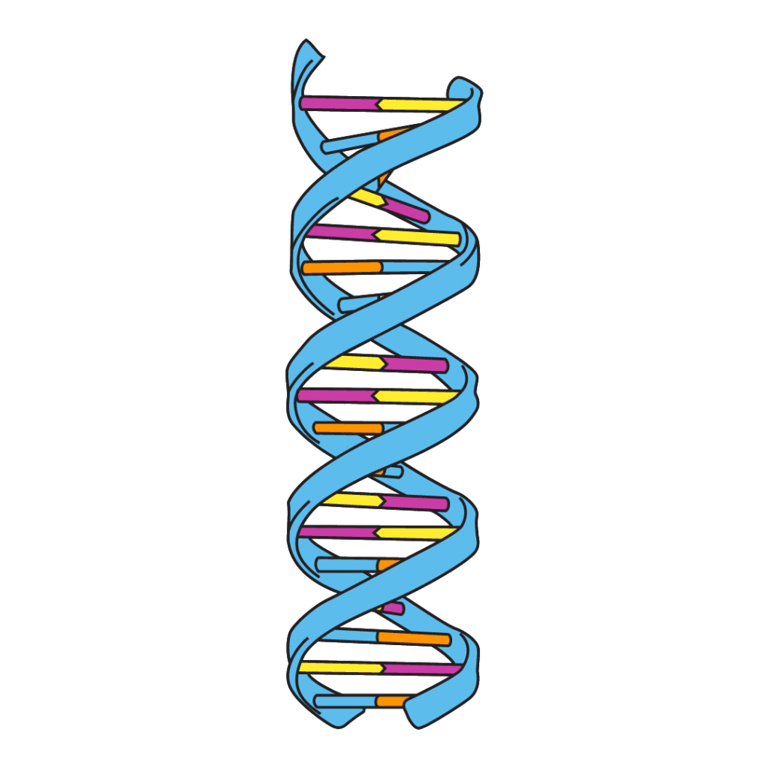
What is DNA and why is it important?
Notes:
Reasons students might say that DNA is important or relevant:
Building blocks of life
Lineage, ethnicity, history, health
Genes genetics family
GATTACA movie, ethics, designer babies

Slide 6
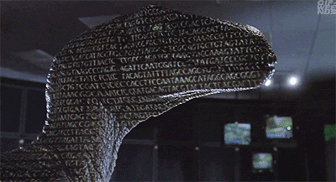
DNA contains the building blocks of life

Slide 7
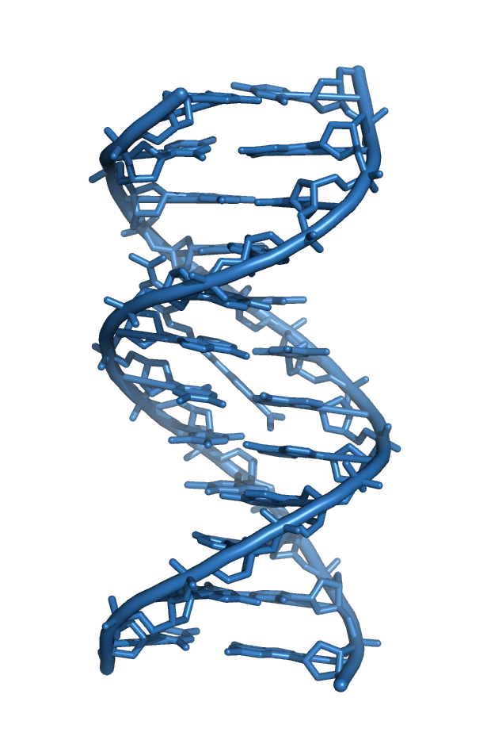
DNA
Let’s discuss DNA and how forensic scientists analyze DNA so that you can solve this crime!

Slide 8
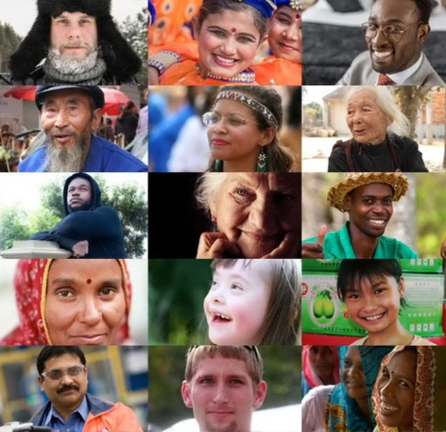
How many base pairs are in the human genome?
3,000
300,000
3 million
3 billion
3 trillion
Notes:
Have students work together in small groups to select their answer and be ready to defend their answer.
Be prepared for possible talking points of race, ethnicity and genetic variation in relation to DNA. Remember that race is a social construct so genetic play a part in race, but do not define racial categories.

Slide 9
How many base pairs are in the human genome?
3,000
300,000
3 million
3 billion
3 trillion

Slide 10
What percent of your DNA is similar to any other person in the world?
We are not all exactly the same
99.9%
98%
90%
60%
10%
Notes:
Have students work together in small groups to select their answer and be ready to defend their answer.

Slide 11
What percent of your DNA is similar to any other person in the world?
We are not all exactly the same
99.9%
98%
90%
60%
10%

Slide 12
Even though we all share 99.9% genetic identity…
3 MILLION bases ARE different!
Using these differences, it is possible to generate a unique “DNA fingerprint” for every individual.

Slide 13
What are some sources of DNA?
Notes:
Ask them to name some sources of DNA and list them on the board before you show them this list.

Slide 14
What are some sources of DNA?
Sweat
Blood
Skin
Semen
Urine
Mucus
Tissue
Ear Wax
Dandruff
Hair
Saliva
Notes:
Ask them to name some sources of DNA and list them on the board before you show them this list.

Slide 15
What are some sources of DNA?
Sweat
Blood
Skin
Semen
Urine
Mucus
Tissue
Ear Wax
Dandruff
Hair
Saliva
Notes:
Ask them to name some sources of DNA and list them on the board before you show them this list.

Slide 16
Ok forensics scientists… Let’s isolate DNA!

Slide 17
DNA Isolation Method
Step 1: Add your saliva to the tube
Step 2: Add 1-2 drops of soap to tube and mix well
Step 3: Add a pinch of salt and mix well
Step 4: Add several droppers full of ethanol and mix well
Step 5: Spool your DNA with stick
Notes:
May also be done with the slightly modified protocol for Wheat Germ DNA Isolation

Slide 18
Baby Guppy wants to know what fishbowl they belong in
Notes:
How could you use DNA to figure out who baby guppy’s family is?

Slide 19
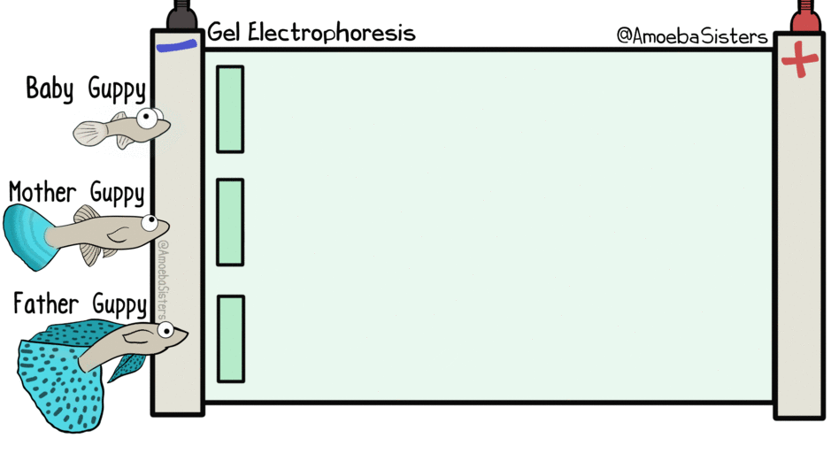
Notes:
Points to make in this slide:
Electrophoresis allows us to separate different lengths of DNA
DNA is negatively charged and so it is attracted to the positive side of the gel apparatus (right side)
Long fragments migrate more slowly through the get
Baby guppy has DNA in common with both the mom and the dad guppy

Slide 20
How do forensic scientists get enough DNA from a tiny sample in order to run an analysis?

Slide 21
PCR can make many copies
in a very short period of time

Slide 22
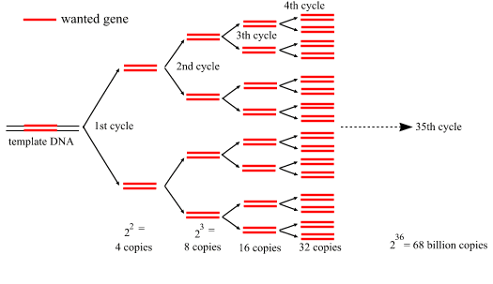

Slide 23
How do we get DNA fragments from all that DNA?
Notes:
Can we rephrase this question?
Ex.

Slide 24
Restriction Enzyme Digest
DNA can be cut into smaller pieces by restriction enzymes that recognize very specific sequences of DNA.
AGCTAGAATTCTTTACGCTCGGATGAATTCCACCTATCTCC
Notes:
You can explain that restriction enzymes are naturally made by bacteria as a defense mechanism

Slide 25
Restriction Enzyme Digest
DNA can be cut into smaller pieces by restriction enzymes that recognize very specific sequences of DNA.
AGCTAGAATTCTTTACGCTCGGATGAATTCCACCTATCTCC
AATTCTTTACGCTCGGATG
AGCTAG
AATTCCACCTATCTCC

Slide 26
Analyzing the DNA
AGCTAGAATTCTTTAATTGGCGATGAATTCCACCTATCTCC
_
M
35
25
20
18
14
12
8
+
Notes:
Let’s imagine that we are analyzing this piece of DNA being digested by ecor1 – how many pieces of DNA would result?

Slide 27
Analyzing the DNA
AGCTAGAATTCTTTAATTGGCGATGAATTCCACCTATCTCC
_
M
35
25
What are the predicted sizes of the DNA fragments after EcoR1 digestion?
20
18
14
12
8
+
Notes:
Let’s imagine that we are analyzing this piece of DNA being digested by ecor1 – how many pieces of DNA would result?

Slide 28
Analyzing the DNA
_
AGCTAGAATTCTTTAATTGGCGATGAATTCCACCTATCTCC
_
M
M
35
35
25
25
20
AATTCTTTACGCTCGGATG (19)
20
18
18
14
14
AATTCCACCTATCTCC (16)
12
12
8
8
AGCTAG (6)
+
+
Notes:
Let’s imagine that we are analyzing this piece of DNA being digested by ecor1 – how many pieces of DNA would result?

Slide 29
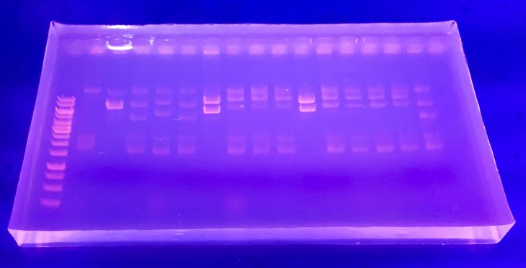
Solving the Crime
Because of variations in our DNA sequence, every person has a unique restriction digest pattern, allowing DNA from a crime scene to be matched to a particular suspect.
This is what an actual agarose gel looks like:
CRIME SCENE
MARKER
Suspects
1
2
3
4
35
25
20
18
14
12
8
Notes:
Point out the marker on the gel as well as the crime scene DNA. Ask them which suspect committed the crime by matching the DNA pattern to the crime scene.
Give time to groups to decide which suspect is the match.
Find better picture of actual gel

Slide 30
Solving the Crime
Because of variations in our DNA sequence, every person has a unique restriction digest pattern, allowing DNA from a crime scene to be matched to a particular suspect.
This is what an actual agarose gel looks like:
CRIME SCENE
MARKER
Suspects
1
2
3
4
35
25
20
18
14
12
8
Notes:
Point out the marker on the gel as well as the crime scene DNA. Ask them which suspect committed the crime by matching the DNA pattern to the crime scene.

Slide 31
Let’s solve the case of the missing mascot!

Slide 32
The Suspects

Slide 33
Analyze your suspect’s DNA
EcoRI cuts the following sequence:
G|AATTC

Slide 34
Analyze your suspect’s DNA
EcoRI cuts the following sequence:
G|AATTC
Find all EcoRI cut sites in the DNA sequence of the suspect you represent

Slide 35
Analyze your suspect’s DNA
EcoRI cuts the following sequence:
G|AATTC
Find all EcoRI cut sites in the DNA sequence of the suspect you represent
Draw the bands on the gel according to their predicted lengths following digestion
Notes:
Match the DNA that

Slide 36
Suspect #1: Will
Sex: Male
Weight: 220 lb.
Height: 6’1”
Position: Captain of the Football Team
M
Thief
35
DNA Sequence:
TCGATGAATTCTATCGGAATTCTCGGACTTCTCGAGAATTCTGCGGATTTCTCGGATTCA
DNA Fragment Sizes: _________________
30
EcoRI: G|AATTC
28
24
20
16
12
10
5
1

Slide 37
Suspect #2: Natalie
Suspect #5: Maggie
Suspect #3: Molly
Suspect #6: Vince
Crime Scene DNA
Suspect #4: Jude
Suspect #7: Liza
DNA Ladder
Suspect #1: Will
35
30
28
24
20
16
12
10
5
1
Notes:
(draw a gel like this on your board and fill it out)
****If you don’t have a preprinted poster of a blank gel, make sure you draw a gel on the board for them to fill in if you are using powerpoint. Alternatively, use the blank gel on this slide printed on an overhead *****
Pass out a suspect sheet to each student.
Have each student go through and find all the EcoRI cut sites, determine the size of each fragment, and draw the DNA pieces on the gel.
Have the students with the same suspect get together and compare their EcoRI digestion analysis.
Have one representative from each group go to the board and drawn their digestion pattern on the gel.
Identify the thief as a class.

Slide 38
Can we ID the thief?
Please PAUSE and analyze your suspect’s DNA.

Slide 39
Suspect #2: Natalie
Suspect #5: Maggie
Suspect #3: Molly
Suspect #6: Vince
Crime Scene DNA
Suspect #4: Jude
Suspect #7: Liza
DNA Ladder
Suspect #1: Will
35
30
28
24
20
16
12
10
5
1
Notes:
(draw a gel like this on your board and fill it out)
Pass out a suspect sheet to each student. It works well to divide students into 7 groups and each group will analyze one of the suspects’ DNA.
Have the students in each group work together to find all the EcoRI cut sites, determine the size of each fragment, and draw the DNA pieces on the gel on their paper.
Have one representative from each group go to the board and drawn their digestion pattern on the gel.
Identify the thief as a class.

Slide 40
Suspect #2: Natalie
Suspect #5: Maggie
Suspect #3: Molly
Suspect #6: Vince
Crime Scene DNA
Suspect #4: Jude
Suspect #7: Liza
DNA Ladder
Suspect #1: Will
35
30
28
24
20
16
12
10
5
1
Notes:
(draw a gel like this on your board and fill it out)
Pass out a suspect sheet to each student. It works well to divide students into 7 groups and each group will analyze one of the suspects’ DNA.
Have the students in each group work together to find all the EcoRI cut sites, determine the size of each fragment, and draw the DNA pieces on the gel on their paper.
Have one representative from each group go to the board and drawn their digestion pattern on the gel.
Identify the thief as a class.

Slide 41
GUILTY!

Slide 42
ETHICAL CONSIDERATIONS
Do you think that it is fair that students are required to submit a DNA sample simply because they are a member of the Senior class?
On what basis should people be required to submit a DNA sample in a criminal investigation?
What are some potential sources for error in such an investigation?
Keeping these in mind, do you think that DNA fingerprinting alone provides substantial enough evidence for positive identification of a criminal?

Slide 43
Think about TV crime dramas…
What kind of forensic analysis do they do?
bite marks
blood spatter
handwriting
ballistics
tool marks
voices
hair
fibers
DNA
Toobin J. New Yorker 30-35, 2007.
Notes:
These tests are not statistically reliable, but they are still allowed in court. Analysis if based on an expert’s judgment, not hard science. DNA analysis is the only test which is mathematically reliable to place a person at the crime scene.

Slide 44
Think about TV crime dramas…
What kind of forensic analysis do they do?
bite marks
blood spatter
handwriting
ballistics
tool marks
voices
hair
fibers
DNA
only evidence which can link a suspect to a crime with mathematical certainty
Toobin J. New Yorker 30-35, 2007.
Notes:
These tests are not statistically reliable, but they are still allowed in court. Analysis if based on an expert’s judgment, not hard science. DNA analysis is the only test which is mathematically reliable to place a person at the crime scene.

Slide 45
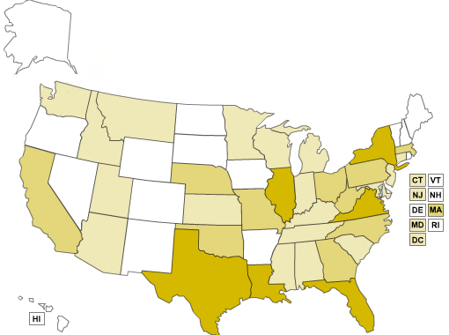
Organization dedicated to exonerating wrongfully convicted people through DNA testing.
As of Feb 2020
375 people in the United States have been exonerated thanks to DNA testing; 21 were originally sentenced to death 14 in the state of NC
© Innocence Project
http://geology.com/state-map/
Notes:
As of January 2020, the Innocence Project has documented over 375 DNA exonerations in the United States. Twenty-one of these exonerees had previously been sentenced to death.
The vast majority (97%) of these people were wrongfully convicted of committing sexual assault and/or murder. Although these individuals were innocent of these crimes, approximately 25% had confessed and 11% had pleaded guilty. These exonerees spent an average of 14 years in prison–10% of whom spent 25 years or more in prison for crimes they didn’t commit.

Slide 46
FAST FACTS
In 1989, The first DNA exoneration took place
Since then, 375 exonerations has occurred thanks to DNA evidence
14 --> The average number of years served
5,284 --> Total number of years served (of 375)
26.6 --> Average age at time of wrongful conviction
43 ---> Average age at exoneration
21 ---> Served time on death row
44 --> Pled guilty to crimes they didn't commit

Slide 47
Ronald Cotton
From innocenceproject.org
Notes:
More info about this case: http://www.innocenceproject.org/cases-false-imprisonment/ronald-cotton

Slide 48
SUMMARY
What are the most important things you learned or considered today?
Notes:
Ask the students what they learned today, or what they think is important to remember about DNA. Write student responses on the board

Slide 49
SUMMARY
Humans share 99.9% identity in DNA sequence
Areas of variability are used by forensic scientists to identify individuals
Every person has a unique DNA fingerprint, which helps match DNA from crime scenes and suspects
DNA evidence is the only evidence that can undeniably identify perpetrators of crime
DNA evidence is important to exonerate wrongly convicted individuals
Notes:
Students may come up with some of these summary points.

