Slide 1


Slide 3
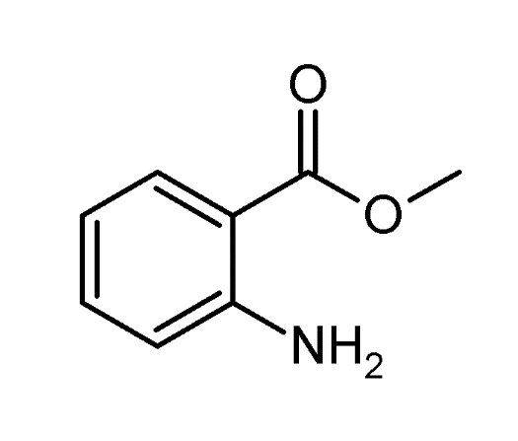
Methyl anthranilate
Artificial grape flavor is a chemical called Methyl anthranilate.
This is just one of many flavoring chemicals that have been found in grape-flavored e-liquid.

Slide 6
Limonene
Limonene is a major component in the oil of citrus fruit peels, like Lemon.
It is also a common additive in e-cigarettes, cosmetic products, and cleaning products.
Limonene can also be used as a solvent.

Slide 9
Isoamyl acetate
Isoamyl acetate is used to confer banana flavor in foods or as an artificial banana flavor.
Because of its pleasant odor and low toxicity, isoamyl acetate is often used to test the effectiveness of gas masks.

Slide 12
Benzaldehyde
Cherry flavor is a chemical called benzaldehyde.
Benzaldehyde is a common flavoring chemical in fruity e-cigarettes.
Benzaldehyde has been indicated as a respiratory and eye irritant.
Toxicity studies at UNC have also shown that benzaldehyde can impair lung immune cell function

Slide 15
Diacetyl
Buttery flavor is a chemical called diacetyl.
Diacetyl is commonly found in popcorn and is safe to eat.
However, popcorn factory workers, who inhaled a large amount of the chemical, suffered from a serious lung disease.

Slide 18
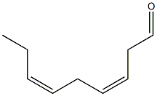
3,6-Nonadienal
Watermelon flavor is a flavoring chemical called: 3,6-nonadienal.
Bidi Stick’s (a commonly used e-cigarette) Lush Ice flavor is a mix of watermelon, melon, and menthol flavors

Slide 21
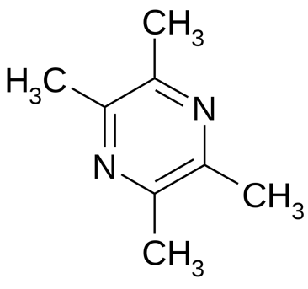
2,3,5,6-tetramethyl pyrazine
Chocolate scent is a flavoring chemical called 2,3,5,6-tetramethyl pyrazine.
This chemical, along with vanillin and maltol, has been found in chocolate-flavored e-liquids

Slide 24
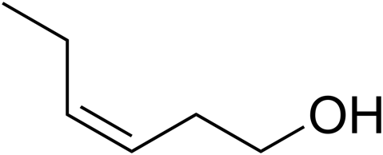
(E)-2-hexen-1-ol
Apple flavor is (E)-2-hexen-1-ol.
This chemical, along with hexyl and ethyl acetate, has been found in apple-flavored e-liquids.

Slide 27
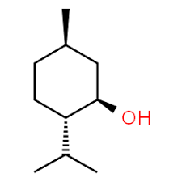
Menthol
Peppermint flavor is primarily the chemical Menthol
Menthol creates a cooling sensation in your airway by activating cold receptor (TRPM8), which is often used to mask throat irritation or harsh taste of chemicals.

Slide 30
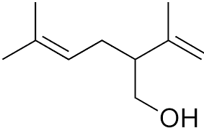
(R)-Lavandulol
Lavender flavor is a mixture of chemicals including: (R)-Lavandulol.
Lavender is a commonly marketed as an “essential oil” and cases of essential oil poisonings are on the rise.
Inhalation large amounts of essential oils have been linked to pneumonia while large amounts of skin exposure have been linked to allergic reactions.

